Slide 1
Chapter 4
The Origins of the Modern State

Slide 2
States & Governance
In framing the government which is to be administered by men over men, the great difficulty lies in this: you must first enable the government to control the governed; and in the next place oblige it to control itself.
- James Madison, The Federalist Papers, No 51
Notes:
This quote captures the chapter—and the main theories for the emergence of the state– here by the state, we mean what most people mean when they say “the government”. Note the inherent tradeoff that a government that is powerful enough to keep people in line will also be powerful enough to deprive them of their liberty.

Slide 3
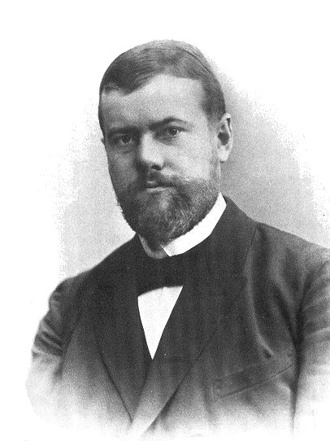
What Is a State?
The most famous definition of the state comes from Max Weber.
“The state is a human community that (successfully) claims the monopoly of the legitimate use of physical force within a given territory.”
Weber’s definition has three components.

Slide 4
What Is a State?
Component #1: A state requires a “given territory”
This distinguishes states from nations.
A state is defined by its territory; a nation by its people
A nation is a group of people who share some sort of common identity.
A nation-state is a state in which a single nation predominates and the legal, social, demographic, and geographic boundaries of the state are connected in important ways to that nation.

Slide 5
What Is a State?
Component #2: The state must have a “monopoly on the legitimate use of physical force.”
The focus on “legitimacy” has troubled many scholars because it’s not always easy to determine what considered legitimate.
Some state violence may be seen as illegitimate by some (Waco, Tiananmen Square, Prague 1968)
Some non-state violence may be seen as legitimate by some (E.g. vigilantism, paramilitary groups)

Slide 6
What Is a State?
Component #3: The state must have a “monopoly on the legitimate use of physical force.”
The focus on monopoly has also troubled scholars.
Any state never perfectly monopolizes violence:
Think of: Irish Republican Army, Al Qaeda, or even the Mafia and organized crime
These forms of violence are sometimes considered legitimate!

Slide 7
What Is a State?
Two additional notable definitions of a state include:
“A state is an organization with a comparative advantage in violence, extending over a geographic area whose boundaries are determined by its power to tax constituents.” (Douglas North)
States are “relatively centralized, differentiated organizations, the officials of which, more or less, successfully claim control over the chief concentrated means of violence within a population inhabiting a large, contiguous territory.” (Charles Tilly)
Notes:
Both Tilly and North’s definitions share Weber’s belief that all states must have a given territory and that they rely on the threat of force to rule. But they’ve softened language regarding ”legitimate” and “monopoly”

Slide 8
What Is a State?
Unlike other social organizations, the state is “a violence producing enterprise.”
All states use the threat of force to organize public life.
States never perfectly monopolize force.
States never perfectly enforce their will.
Coercion may be justified in different ways and may be used for different purposes and with different effects. But all states use it.

Slide 9

States and Coercion
Willie Nelson was coerced.

Slide 10
What Is a State?
A failed state is a state-like entity that cannot coerce and is unable to successfully control the inhabitants of a given territory
(potential) Examples include Afghanistan, the Central African Republic, Syria, Somalia, South Sudan, and Yemen
A failed state has failed because it is not able to fulfill the functions of a state as it has not successfully claimed the right of coercion in a given territory.

Slide 11
Syria: A Failed State
March 2011, protests broke out in response to the arrest and torture of some teenagers who had sprayed anti-regime slogans on a wall.
The protests led to further demonstrations and protesting and violent confrontations.
We’ll talk about the ”cascading” nature of many revolutions and protests in Chapter 7.
Ultimately, the protests turned into an open civil war.

Slide 12
Syria: A Failed State
The collapse of the Syrian state has been devastating for all Syrians.
Since the violence began, more than 465,000 Syrians have been killed and another million injured.
The Syrian civil war has left about twelve million people displaced!?!

Slide 13
Syria: A Failed State
How Unusual Is Syria?
It is not unique.
There are other countries that are classified as fragile states.
The Fragile States Index classifies countries into four categories:
Alert, Warning, Stable, Sustainable
Classification is based on scores they get on twelve social, economic, and political indicators.

Slide 14
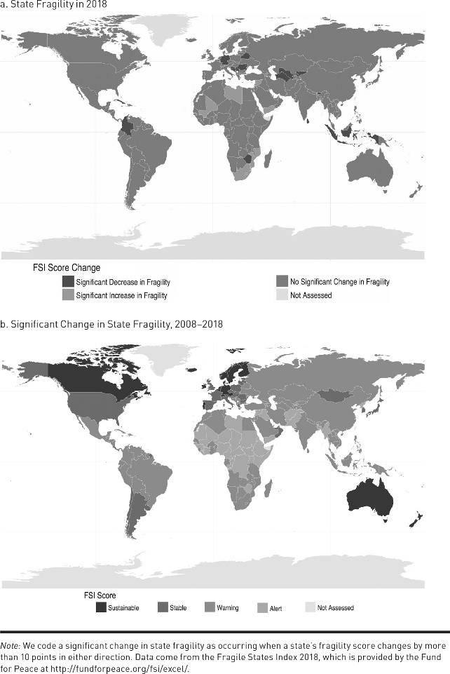
Syria: A Failed State

Slide 15
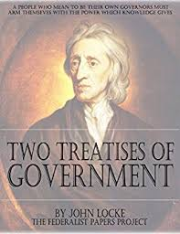
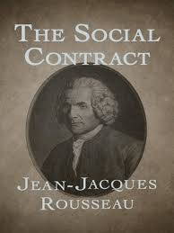
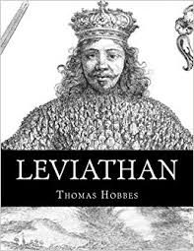
Social Contract Theorists
Hobbes
Leviathan
1651
Locke
Two Treatises
1689
Rousseau
The Social Contract
1762

Slide 16
The Contractarian View of the State
The creation of the state results from a social contract between individuals in the state of nature in which the state provides security in exchange for obedience from the citizen.

Slide 17
The Contractarian View of the State
The State of Nature
The state of nature is a term used to describe situations in which there is no state (no government).
Hobbes believed that individuals in the state of nature faced a dilemma:
Without a “common power to keep them all in awe,” the people will choose to steal and kill.
It’s rob or be robbed in the state of nature

Slide 18
The Contractarian View of the State
Civil Society and the Social Contract
Hobbes’s solution was to create the “Sovereign.”
The sovereign was to be created by an implicit social contract between individuals in the state of nature.
Individuals would “contract” with each other to give up their natural rights in exchange for civil rights that would be protected by the sovereign.

Slide 19
The Contractarian View of the State
Civil Society and the Social Contract
Theorists view the state as a third-party enforcer who can dole out punishments to individuals who engage in behavior that violates the social contract.
Why would we want this?
The sovereign agrees to police the citizenry in exchange for taxes that citizens pay.

Slide 20
The Contractarian View of the State
Civil Society and the Social Contract
The state may be a solution to the state of nature.
For this to occur, though, it must be the case that:
The punishment imposed by the state for stealing is sufficiently large that individuals prefer to refrain rather than steal.
The state needs to make sure that crime doesn’t pay!
The taxation rate charged by the state for acting as the policeman must not be so large that individuals prefer the state of nature (no state) to civil society (state).

Slide 21
The Predatory View of the State
The predatory view of the state holds that states that exercise an effective control over the use of violence are in a position to threaten the security of citizens.
This makes it possible for them to exploit the citizens that, according to the contractarian view of the state, they have a duty to protect.

Slide 22
The Predatory View of the State
States are like individuals in the state of nature.
They face their own security dilemma in the sense that they have potential rivals always vying to take their place.
The concern for security leads states to use their power to extract resources from others, that is, to be predatory.

Slide 23
The Predatory View of the State
Tilly claims that states resemble a form of organized crime and that they should be viewed as extortion or protection rackets.
The predatory approach sees the state as an organization that trades security for revenue.
BUT, the difference is that the seller of security in the predatory approach happens to represent the key threat to the buyer’s continued security.

Slide 24
The Predatory View of the State
After the decline of the Roman Empire, Europe was composed of local lords who offered protection to peasants in exchange for rents.
Over time feudal lands were consolidated into larger holdings controlled by kings.
The political geography of Europe is a function of the strategies by lords to remain in power.

Slide 25
The Predatory View of the State
This change in the balance of power between local lords and feudal kings in early modern Europe was aided by a change in the “economies of scale” in the use of violence.
The desire to exploit the “economies of scale in protection” created incentives for entrepreneurial rulers to conquer neighboring rulers.

Slide 26
The Predatory View of the State
To remain in power, lords and kings engaged in four primary activities:
1) War making: eliminating their rivals outside their territories
2) State making: eliminating their rivals inside their territories
3) Protection: eliminating the enemies of their clients
4) Extraction: acquiring resources to do 1-3

Slide 27
The Predatory View of the State
The modern state arose as a by-product of the attempts of leaders to survive.
External geopolitical pressures and changes in military technology meant that lords needed to increase their war-making capacity to protect themselves and their subjects from the attack of external rivals.
“War makes states.” (Tilly)

Slide 28
The Predatory View of the State
The need to extract resources from their clients often placed constraints on the predation of early modern leaders.
Don’t want to tax too much because this inhibits investment.
If you don’t predate too much, then you might be able to benefit from voluntary compliance.
By regulating their predatory instincts, rulers could opt to increase their net extractive capacity by reducing the costs of conducting business and by taking a smaller portion of a larger pie.

